Slide 1
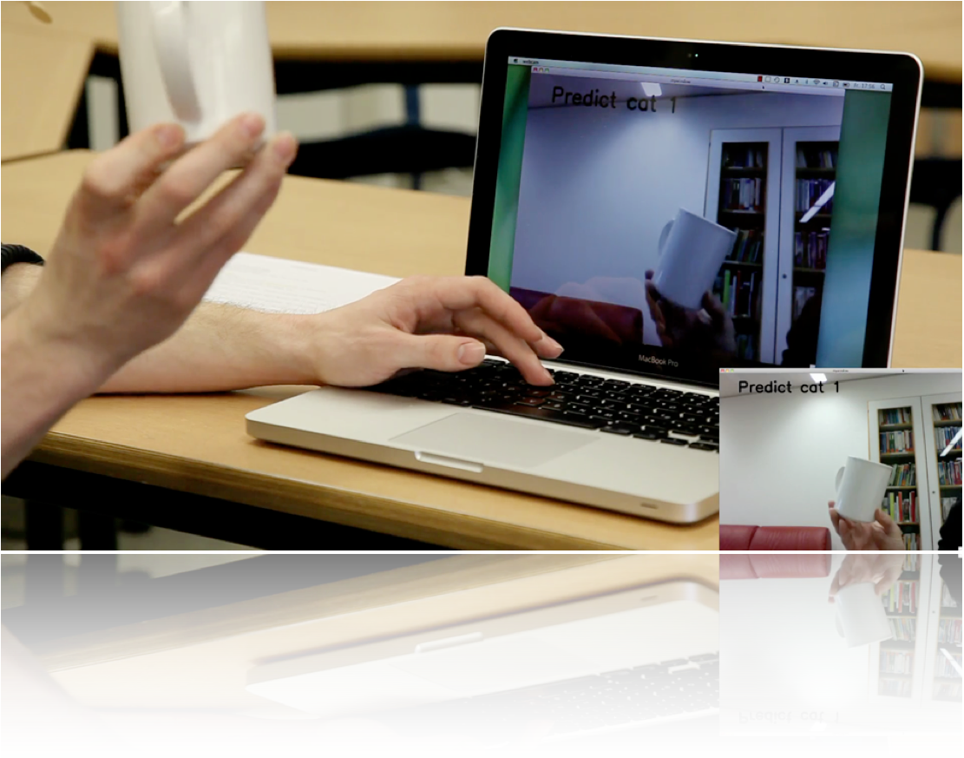
Massively Parallel Multiclass Object Recognition
Helmut Sedding, Ferdinand Deger,
Holger Dammertz, Jan Bouecke, Hendrik P.A. Lensch
Object recognition according to Mutch&Lowe
Cortex-like structure very compute-intensive
Real-Time on mobile devices

Slide 2
Massively Parallel Multiclass Object Recognition
Helmut Sedding, Ferdinand Deger, Holger Dammertz, Jan Bouecke, Hendrik P. A. Lensch
Fast, accurate CUDA impl.
Faster than other GPU impl.
Highly scalable:
Very large images
Real-Time recognition on mobile devices

